Slide 1
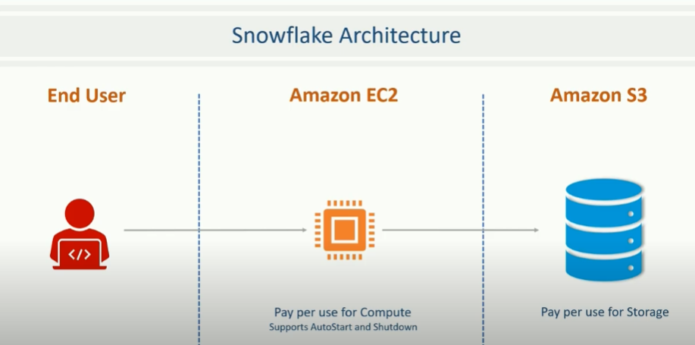
Snowflake – Architecture

Slide 2
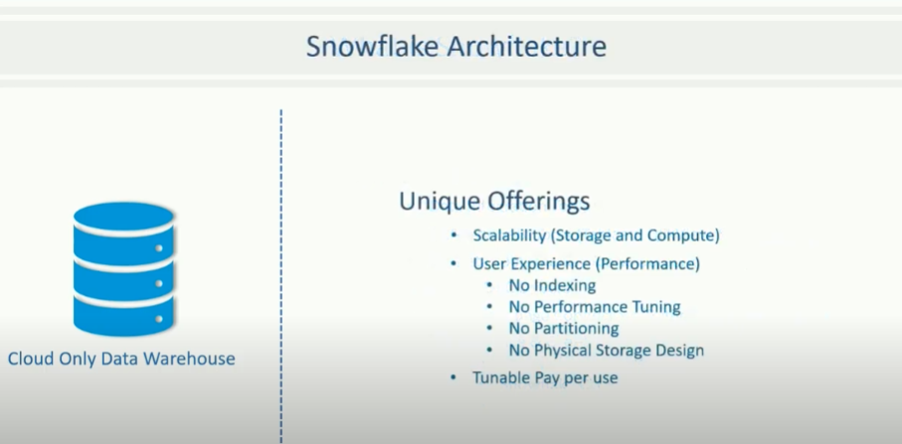
Snowflake – Architecture

Slide 3
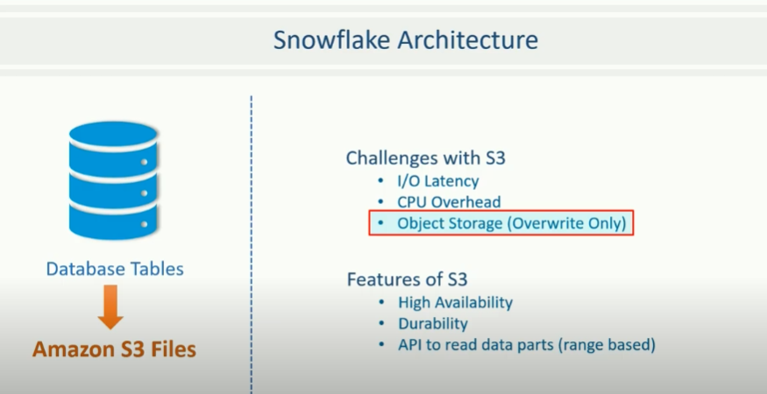
Snowflake – Architecture

Slide 4
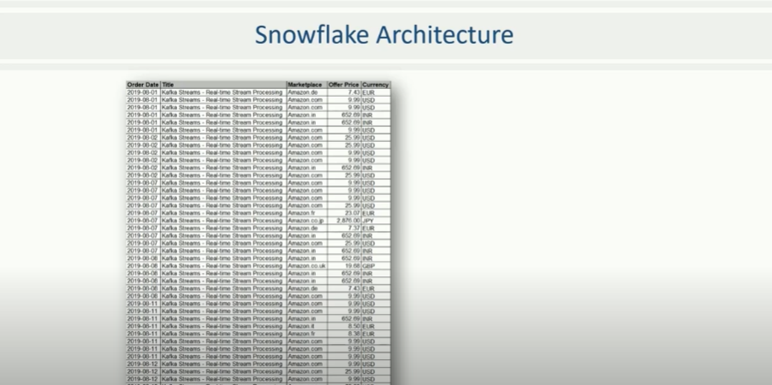
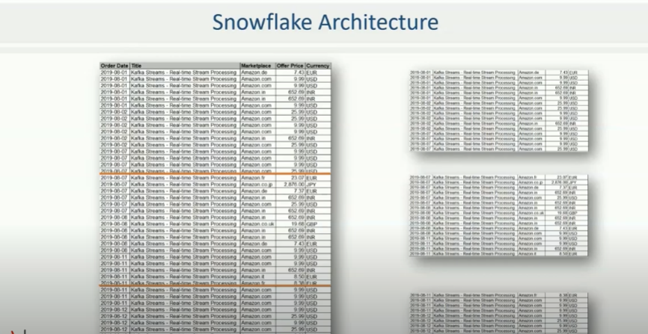
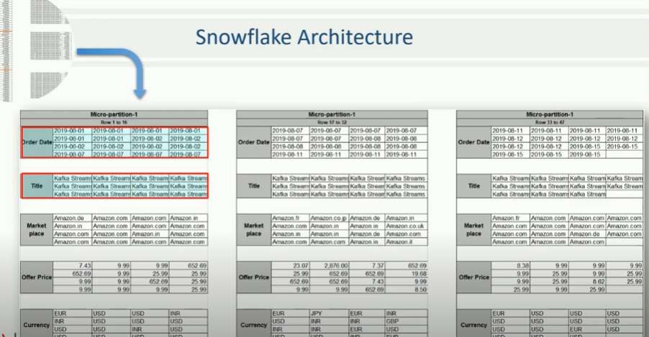
Snowflake – Architecture

Slide 5
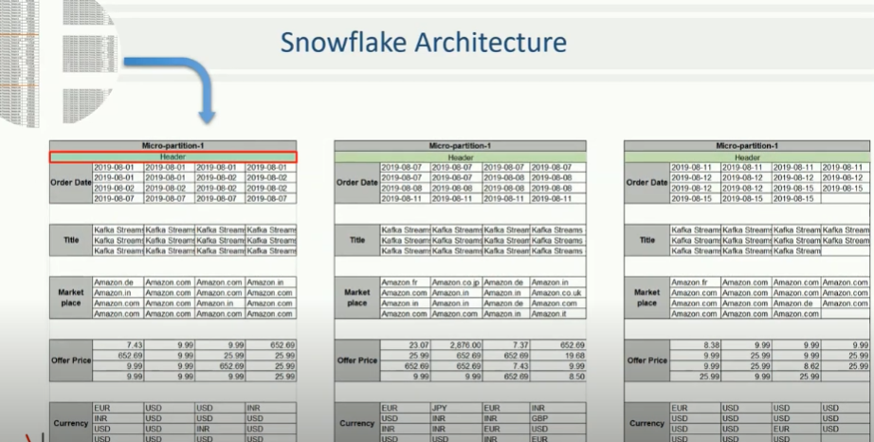
Snowflake – Architecture

Slide 6
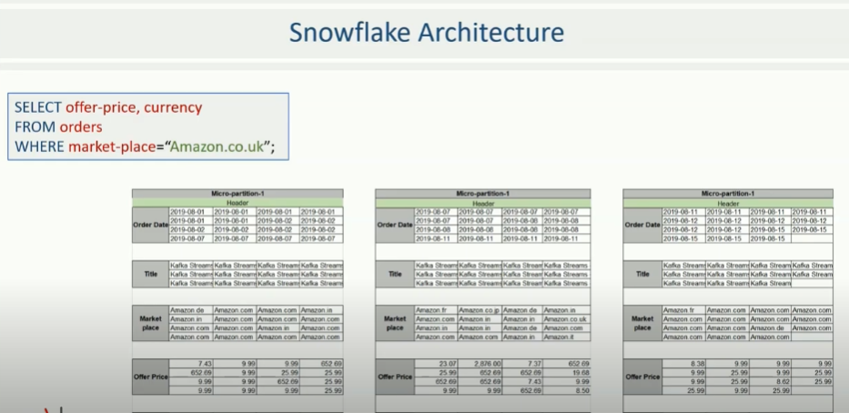
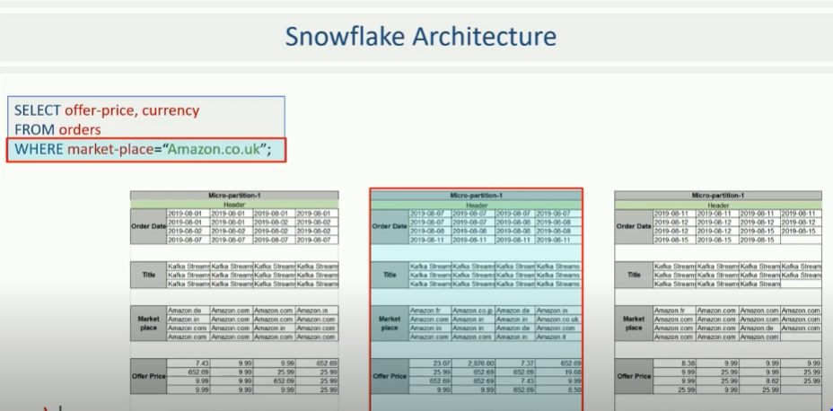
Snowflake – Architecture

Slide 7
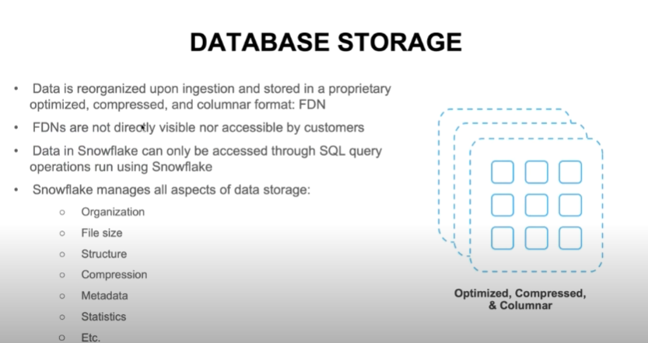
Snowflake – Architecture

Slide 8
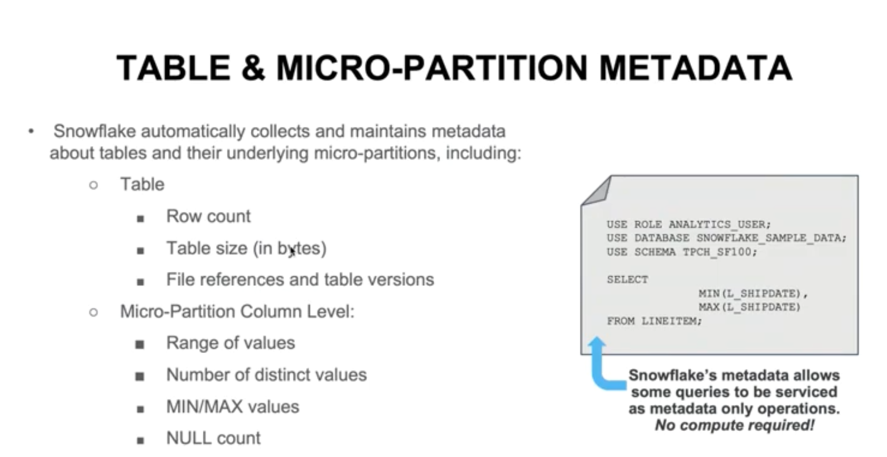
Snowflake – Architecture

Slide 9
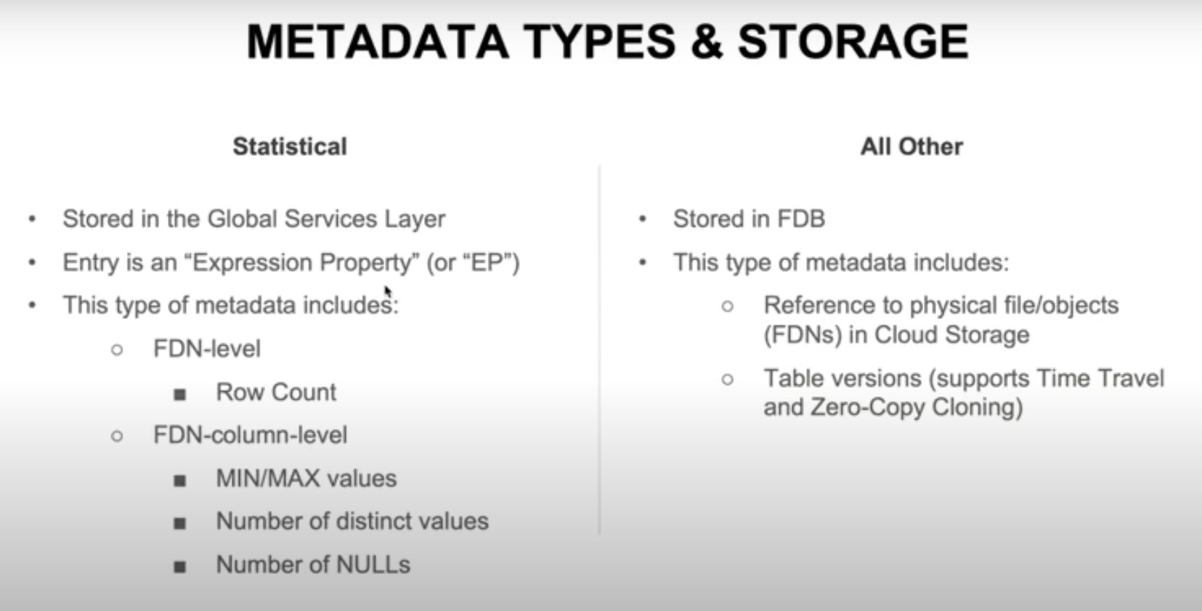
Snowflake – Architecture

Slide 10
Snowflake – Micro Partition
Micropartition:
All data in Snowflake tables is automatically divided into micro-partitions, which are contiguous units of storage
Each micro-partition contains between 50 MB and 500 MB of uncompressed data
Groups of rows in tables are mapped into individual micro-partitions, organized in a columnar fashion
Snowflake micro-partitions are derived automatically; they don’t need to be explicitly defined up-front or maintained by users.
Enables extremely efficient DML and fine-grained pruning for faster queries.
Columnar storage for Columns and also compressed
Snowflake uses columnar scanning of partitions so that an entire partition is not scanned if a query only filters by one column.
A query that specifies a filter predicate on a range of values that accesses 10% of the values in the range should ideally only scan 10% of the micro-partitions.
Assume a large table contains one year of historical data with date and hour columns A query targeting a particular hour would ideally scan 1/8760th of the micro-partitions in the table and then only scan the portion of the micro-partitions that contain the data for the hour column
Snowflake does not prune micro-partitions based on a predicate with a subquery, even if the subquery results in a constant
The micro-partition metadata maintained by Snowflake enables precise pruning of columns in micro-partitions at query run-time, including columns containing semi-structured data
Clustering :
Data stored in tables is sorted/ordered along natural dimensions (e.g. date and/or geographic regions). This “clustering” is a key factor in queries because table data that is not sorted or is only partially sorted may impact query performance, particularly on very large tables

Slide 11
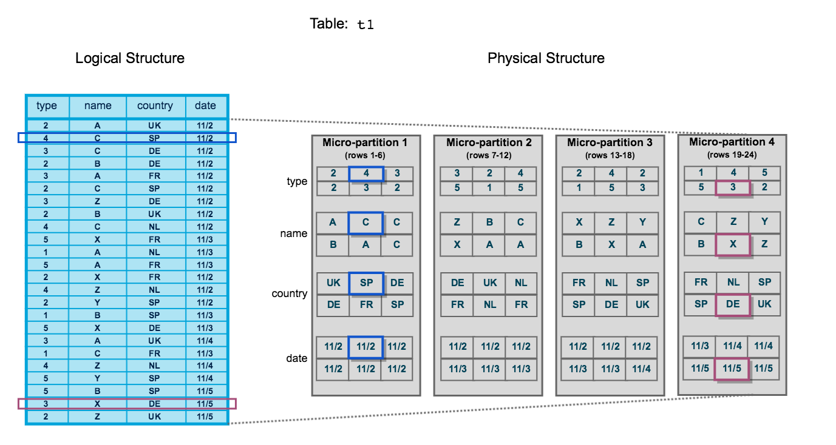
Snowflake – Micro Partition
Clustering: Snowflake leverages this clustering information to avoid unnecessary scanning of micro-partitions during querying, significantly accelerating the performance of queries that reference these columns. First, prune micro-partitions that are not needed for the query. Then, prune by column within the remaining micro-partitions. The total number of micro-partitions that comprise the table. The number of micro-partitions containing values that overlap with each other (in a specified subset of table columns). The depth of the overlapping micro-partitions.

Slide 12
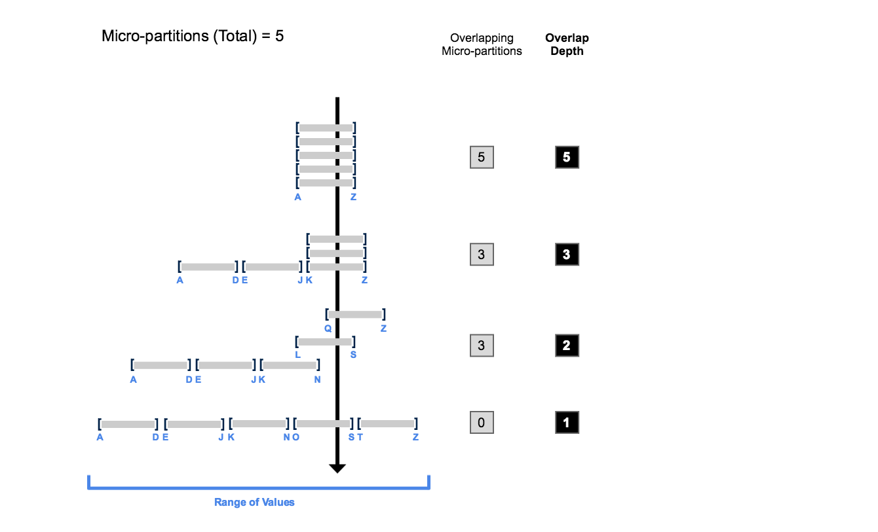
Snowflake – Micro Partition
Clustering Depth:
Monitoring the clustering “health” of a large table, particularly over time as DML is performed on the table. Determining whether a large table would benefit from explicitly defining a clustering key. Table consisting of five micro-partitions with values ranging from A to Z, and illustrates how overlap affects clustering depth:

Slide 13
Snowflake – Micro Partition
Clustering Information For Tables:
SYSTEM$CLUSTERING_DEPTH -- Computes the average depth of the table according to the specified columns (or the clustering key defined for the table). The average depth of a populated table (i.e. a table containing data) is always 1 or more. The smaller the average depth, the better clustered the table is with regards to the specified columns. select system$clustering_depth('TPCH_ORDERS’); select system$clustering_depth('TPCH_ORDERS', '(C2, C9)’); select system$clustering_depth('TPCH_ORDERS', '(C2, C9)', 'C2 = 25'); SYSTEM$CLUSTERING_INFORMATION (including clustering depth) – Returns a Json With all the Details select system$clustering_information('test2', '(col1, col3)');
Clustering Key: A clustering key is a subset of columns in a table (or expressions on a table) that are explicitly designated to co-locate the data in the table in the same micro-partitions. Multi-terabyte (TB) range will experience the most benefit from clustering, particularly if DML is performed regularly/continually on these tables. General indicators that can help determine whether to define a clustering key for a table Queries on the table are running slower than expected or have noticeably degraded over time. The clustering depth for the table is large. Benefits: Improved scan efficiency in queries by skipping data that does not match filtering predicates. Better column compression than in tables with no clustering. This is especially true when other columns are strongly correlated with the columns that comprise the clustering key. After a key has been defined on a table, no additional administration is required, unless you chose to drop or modify the key. All future maintenance on the rows in the table (to ensure optimal clustering) is performed automatically by Snowflake.

Slide 14
Snowflake – Micro Partition
Selecting Cluster Keys: Columns that are mostly used in the Where Clause Add Columns that are used in join predicates (dept.deptno = emp.deptno) A large enough number of distinct values to enable effective pruning on the table. A small enough number of distinct values to allow Snowflake to effectively group rows in the same micro-partitions. A column with Low Cardinality (M/F) yield minimal Pruning A column with Very High Cardinality also not a good candidate for Cluster Key High cardinality Cluster key is Expensive to maintain To Use High Cardinality Column as cluster key define the Key as Expression to reduce the distinct values (Eg Date from Time Stamp, Truncate(ID,-5)) Multi-column Clustering Key – Columns order in Cluster By Clause – Lowest Cardinality to Highest Cardinality Re-Clustering: As DML operations (INSERT, UPDATE, DELETE, MERGE, COPY) are performed on a clustered table, the data in the table may become less clustered. Periodic/regular reclustering of the table is required to maintain optimal clustering.

Slide 15
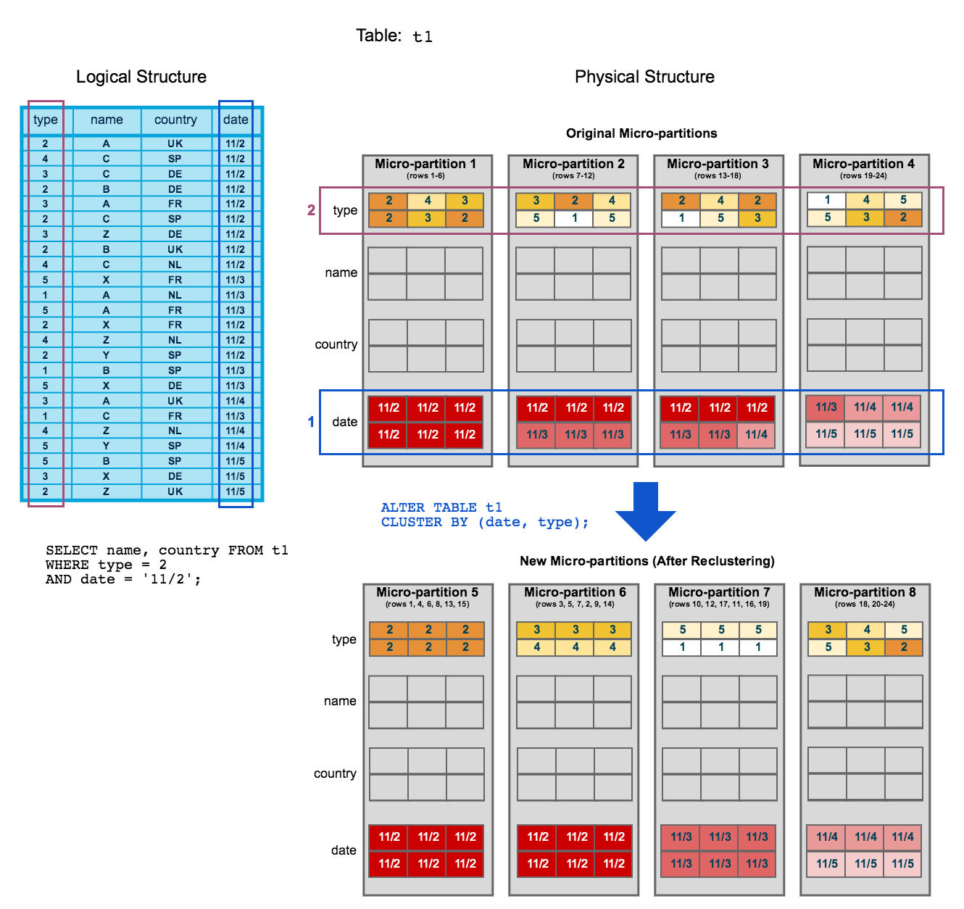
Snowflake – Micro Partition
Re-Clustering: As DML Operations makes the clustered table less clustered. Periodic/regular reclustering of the table is required to maintain optimal clustering. Snowflake uses the clustering key to reorganize the column data, related records are relocated to the same micro partition.

Slide 16
Snowflake – Micro Partition
Re Clustering: To start, table t1 is naturally clustered by date across micro-partitions 1-4. The query (in the diagram) requires scanning micro-partitions 1, 2, and 3. date and id are defined as the clustering key. When the table is reclustered, new micro-partitions (5-8) are created. After reclustering, the same query only scans micro-partitions 5 and 6. Micro-partition 5 has reached a constant state (i.e. it cannot be improved by reclustering) and is therefore excluded when computing depth and overlap for future maintenance. In a well-clustered large table, most micro-partitions will fall into this category. The original micro-partitions (1-4) are marked as deleted, but are not purged from the system; they are retained for Time Travel and Fail-safe. Clustering Key : create or replace table t1 (c1 date, c2 string, c3 number) cluster by (c1, c2); show tables like 't1’; By Expression create or replace table t2 (c1 timestamp, c2 string, c3 number) cluster by (to_date(c1), substring(c2, 0, 10)); show tables like 't2’; Cluster By Paths in Variant create or replace table t3 (t timestamp, v variant) cluster by (v:"Data":id::number); show tables like 'T3’; Changing the Cluster Key Columns alter table t1 cluster by (c1, c3); show tables like 't1’; alter table t2 cluster by (substring(c2, 5, 15), to_date(c1)); alter table t3 cluster by (v:"Data":name::string, v:"Data":id::number); Dropping Cluster → alter table t1 drop clustering key;

Slide 17
Snowflake – Micro Partition
Automatic Clustering : Automatic Clustering is the Snowflake service that seamlessly and continually manages all reclustering Benefits of Automatic Clustering: Ease-of-maintenance Full Control Non-blocking DML Optimal Efficiency Credit and Storage Impact of Reclustering: Similar to all DML operations in Snowflake, reclustering consumes credits. The number of credits consumed depends on the size of the table and the amount of data that needs to be reclustered. Reclustering also results in storage costs. Each time data is reclustered, the rows are physically grouped based on the clustering key for the table, which results in Snowflake generating new micro-partitions for the table. Adding even a small number of rows to a table can cause all micro-partitions that contain those values to be recreated. This process can create significant data turnover because the original micro-partitions are marked as deleted, but retained in the system to enable Time Travel and Fail-safe. The original micro-partitions are purged only after both the Time Travel retention period and the subsequent Fail-safe period have passed, This typically results in increased storage costs AUTOMATIC_CLUSTERING_HISTORY select * from table(information_schema.automatic_clustering_history( date_range_start=>'2018-04-10 13:00:00.000 -0700', date_range_end=>'2018-04-10 14:00:00.000 -0700’)); select * from table(information_schema.automatic_clustering_history( date_range_start=>dateadd(d, -7, current_date), date_range_end=>current_date, table_name=>'mydb.myschema.mytable'));

Slide 18




Dynamic Caching for Optimal Query Performance
Result Cache
All query results stored for 24 hours unless underlying data changes
Identical queries are returned instantly without
requiring compute
01010
01101
00011
Cloud Services
Metadata Cache
Improves compile times for queries against commonly used tables
Virtual
Warehouses
Virtual Warehouse Cache
Data loaded into warehouses is stored in local SSD storage
Cache entries are invalidated if underlying data changes
Database
Storage
Amazon S3

Slide 19






Query Execution
1
5
₁ Query received by Snowflake
Sent via standard ODBC, JDBC, or web UI interfaces
SQL
3
01010
01101
00011
2
Result cache lookup
2 If the query matches an entry in the result cache then the result
is returned immediately
4
Planner and optimizer process query
3 Prune and filter, then use metadata to identify exact data to be processed (or retrieved from result cache)
Virtual warehouse processing
Virtual warehouse scans only needed data from local SSD cache or Amazon S3, processes, and returns to cloud services
4
Result set return
Final result processed, stored in cache for future use, and returned to client
Amazon S3
5

Slide 20
Snowflake – Micro Partition
Query Performance:
Is the query queuing, i.e. not executing at all?
Is the query spilling to local or external storage?
Is the query creating more rows than expected?
Is the query not using pruning as well as it could?
Are there problems with the join order?
Sometimes the expectations for the query performance are based on having it seen running very quickly in the past. Check Understanding Result Caching

Slide 21
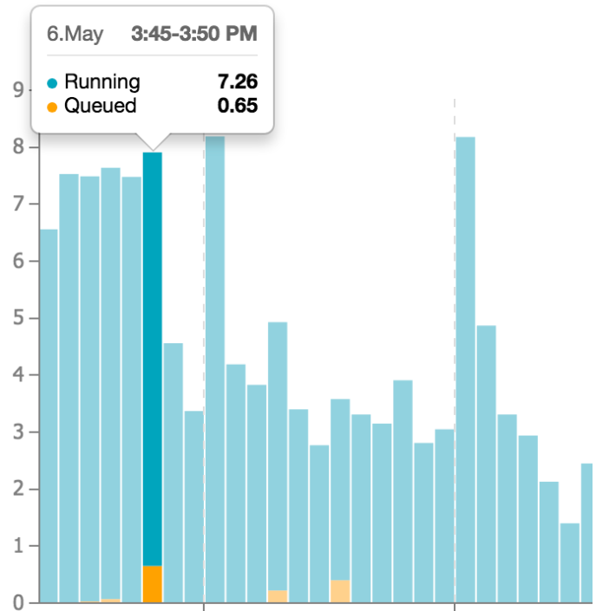
Snowflake – Micro Partition
In general, Snowflake executes queries quickly and doesn't require intervention, so often a slow query is the symptom of a mistake in the way the query is written.
Query Queuing The following is a list of things to check to identify the cause of slow running queries. Is the query queuing, i.e. not executing at all? QUEUED_LOAD: The query is queued because the warehouse is currently overloaded. QUEUED_RESUMING: the warehouse is resuming. The query will execute once the warehouse is available. QUEUED_REPAIR: a faulty server is being automatically replaced by a healthy one. This is a rare condition that can happen in the case of hardware failures. To determine the current load, two factors are considered: current resource consumption (RAM and CPU) The number of queries already executing. The number of queries that can execute in parallel on a warehouse is configurable by setting the parameter MAX_CONCURRENCY_LEVEL Once queued, a query waits for upwards of the amount of time specified by the STATEMENT_QUEUED_TIMEOUT_IN_SECONDS in seconds. If the timeout length is exceeded, the query is aborted

Slide 22
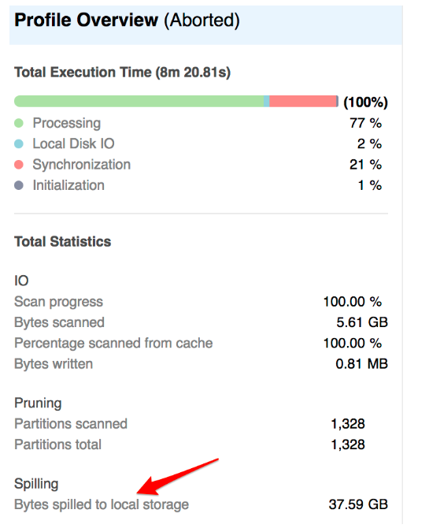
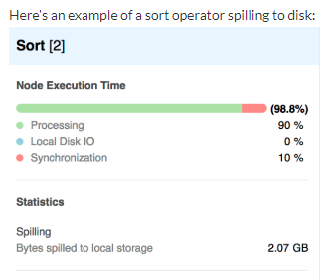
Snowflake – Micro Partition
Query spilling to local or external storage: To see if a query is spilling to disk, look at the right-hand side of the Profile tab in the web interface Solution To optimize a query that is spilling a lot of data, the best approach is to reduce the number of rows that must processed. Data clustering is often very effective for this as it allows Snowflake in many cases to only read the appropriate subset of the data that is really needed

Slide 23
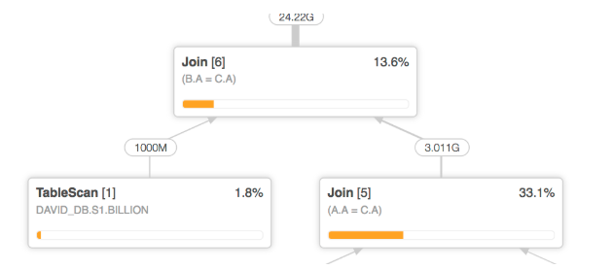
Snowflake – Micro Partition
Row Explosion: A common cause of slow queries is joins that produce more rows than the query author anticipated. This is often referred to as “row explosion”. An easy way to recognize these is to check the query profile for join operators that display more rows in the output than in either of the input links. An example is shown below: The join receives a billion rows from one side, and about 3 billion rows from the other. But it is generating more than 20 billion rows In many cases, however, it is the result of an erroneous join condition. An extreme case is if the join condition is missing completely; in that case, the number of rows produced will be equal to the product of the number of rows on both sides. Look for missing join Conditions

Slide 24
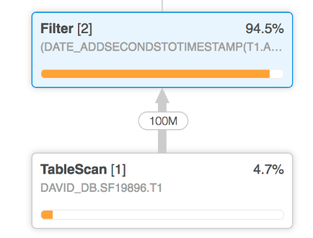
Snowflake – Micro Partition
UNSATISFACTORY PRUNING: Snowflake makes extensive use of pruning to reduce the amount of data that has to be read from storage Look for Subqueries in the Sql STMT Optimal Scan is 10 Percent of total Micro Partitions In this situation, we see that there is a filter immediately after the table scan removed almost all of the rows read from disk. This means that the performance could be dramatically improved by more efficient pruning Solution To improve pruning, the general recommendation is to consider whether clustering can be improved

Slide 25
Snowflake – Micro Partition
CONTROL JOIN ORDER: In some rare situations, it is not possible for the optimizer to identify the join ordering that would result in the fastest execution. In these cases it may be desirable to exercise more control over this aspect of query execution In this situation, we see that there is a filter immediately after the table scan removed almost all of the rows read from disk. This means that the performance could be dramatically improved by more efficient pruning Solution The solution for this is to use temporary tables. For example, consider a query like the following: SELECT x,y FROM T1 INNER JOIN T2 USING (z) INNER JOIN T3 USING (w); Looking at the query profile, you notice that Snowflake joins T2 and T3 first, and then joins the results to T1. Using your additional knowledge of the data, you determine that this is not the fastest approach. In that case, you can write the following: CREATE TEMPORARY TABLE temp1 AS SELECT x,y,z,w FROM T1 INNER JOIN T2 USING (z); SELECT x,y FROM temp1 INNER JOIN T3 using (w); This approach guarantees that the joins are executed in your preferred order. When to Use this Solution The typical situation where this may make sense is when the query profile shows both of the following conditions for a JOIN operator: A large number of rows on the left-hand input, and a much lower number on the right hand. A significant percentage of the overall query execution time spent in the join operator

Slide 26
Snowflake – Common Table Expressions
CTE – Common Table Expressions
Named Sub Query Defined with “WITH” clause
Temporary View
Eg: with MY_CTE (CTE_COL_1, CTE_COL_2) AS ( SELECT COL_1, COL_2 FROM ... ) select ... from my_cte;
Recursive CTE & Non Recursive CTE
Non Recursive CTE
select emps.title, emps.employee_id, mgrs.employee_id as manager_id, mgrs.title as "MANAGER TITLE" from employees as emps left outer join employees as mgrs on emps.manager_id = mgrs.employee_id order by mgrs.employee_id nulls first, emps.employee_id;
Recursive CTE
Anchor Clause and Recursive Clause
with recursive managers
(indent, employee_id, manager_id, employee_title)
as
(
-- Anchor Clause
select '' as indent, employee_id, manager_id, title as employee_title
from employees
where title = 'President'
union all
-- Recursive Clause
select indent || '--- ',
employees.employee_id, employees.manager_id, employees.title
from employees join managers
on employees.manager_id = managers.employee_id
)
select indent || employee_title as title, employee_id, manager_id
from managers

Slide 27
Snowflake – Common Table Expressions
Limit the Results in Recursive CTE
with recursive t(n) as
( select 1 union all select n + 1 from t )
select n from t limit 10;
Connect By , Prior - Works like Self Join
select employee_id, manager_id, title
from employees
start with title = 'President'
connect by
manager_id = prior employee_id
order by employee_id;
SYS_CONNECT_BY_PATH
select sys_connect_by_path(title, ' -> '), employee_id, manager_id, title
from employees
start with title = 'President'
connect by
manager_id = prior employee_id
order by employee_id;
Diff Between Self Join , CTE and Connect By Clauses
Connect By – like a Self join – no need to write
Recursive CTEs are more powerful.. Helps in Ordering , joining different tables ..
Connect by Cannot support ordering

